Slide 1
ML Model Evaluation & Introduction to FACCT ML
Dr. Sugata Ghosal
CSIS Off-Campus Faculty
BITS Pilani

Slide 2
Agenda
Comparing ML Classifiers ( Was already covered in respective modules. Confusion matrix based metrics , RMSE, R2, AUC-ROC, Cross Validation)
Emerging Requirements
Bias and Fairness
Interpretability
Transparency

Slide 3

Model Guide

Slide 4
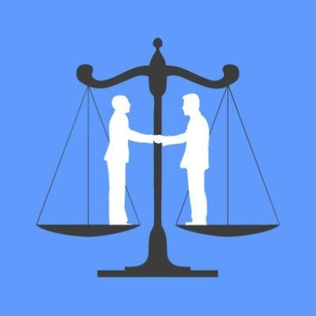
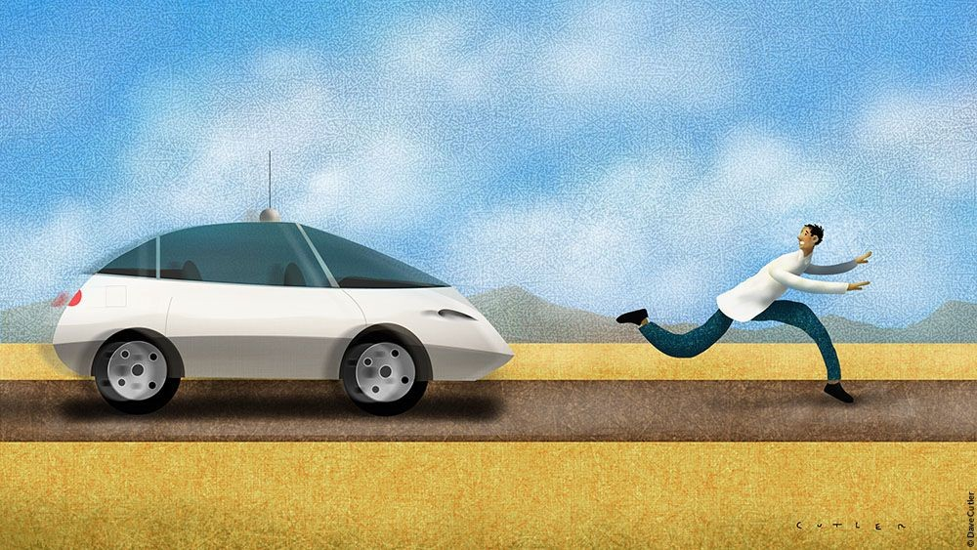

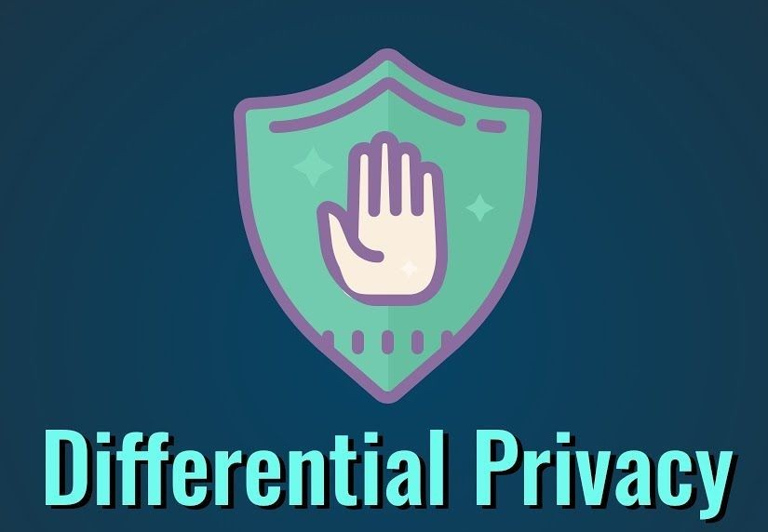
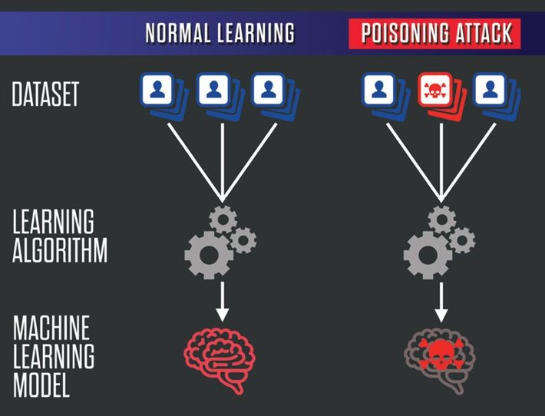
Emerging Requirements
Fairness
What to do to ensure gender and ethnic fairness in ML models?
Accountability
Who takes the responsibilities for failed ML models?
Transparency
What to do to make ML models transparent and comply with regulations?
Privacy Issues
How to protect user privacies when exposing data to ML models?
Security Issues
How do we defend ML models against data poisoning?

Slide 5
FAccT Overview (More on this is a part of next semester elective)
Psychology Social Science Public Policy
Fairness
Accountability
Statistics
Theory
Transparency
Machine Learning
Privacy
Robustness

Slide 6
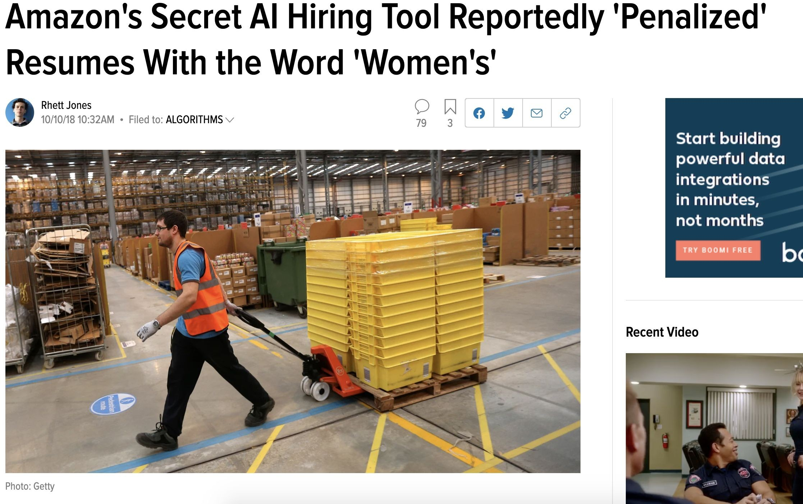
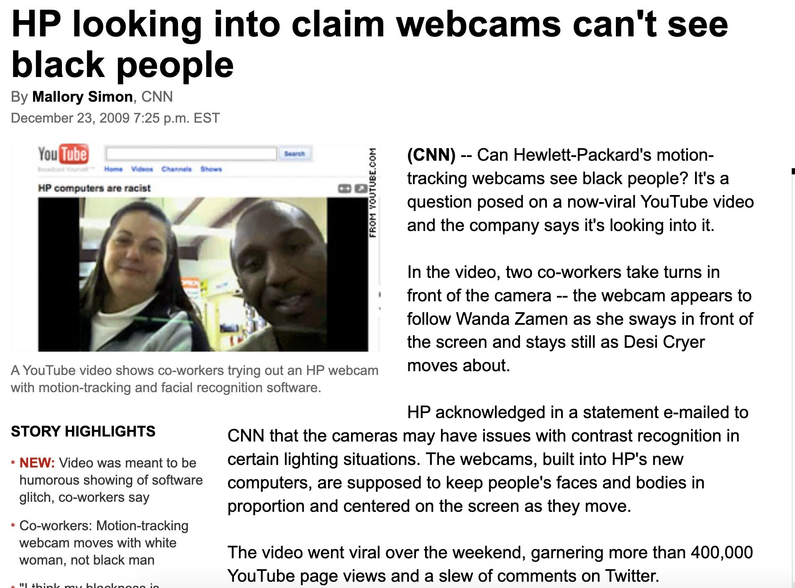
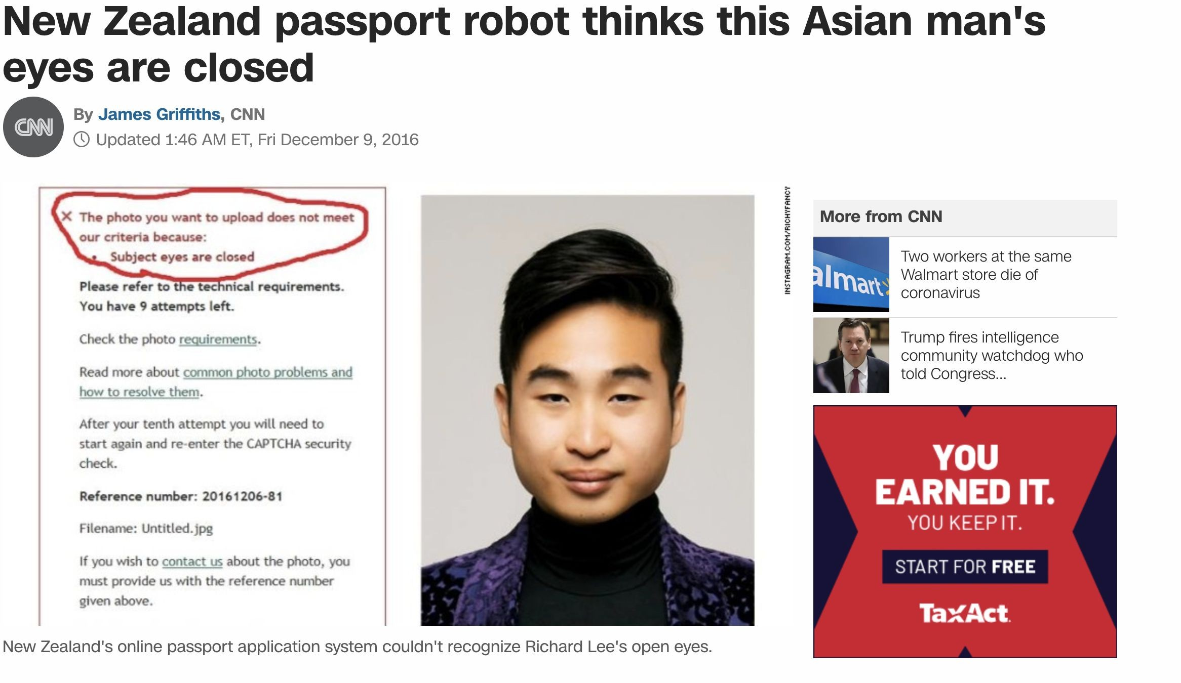
Real World Example

Slide 7
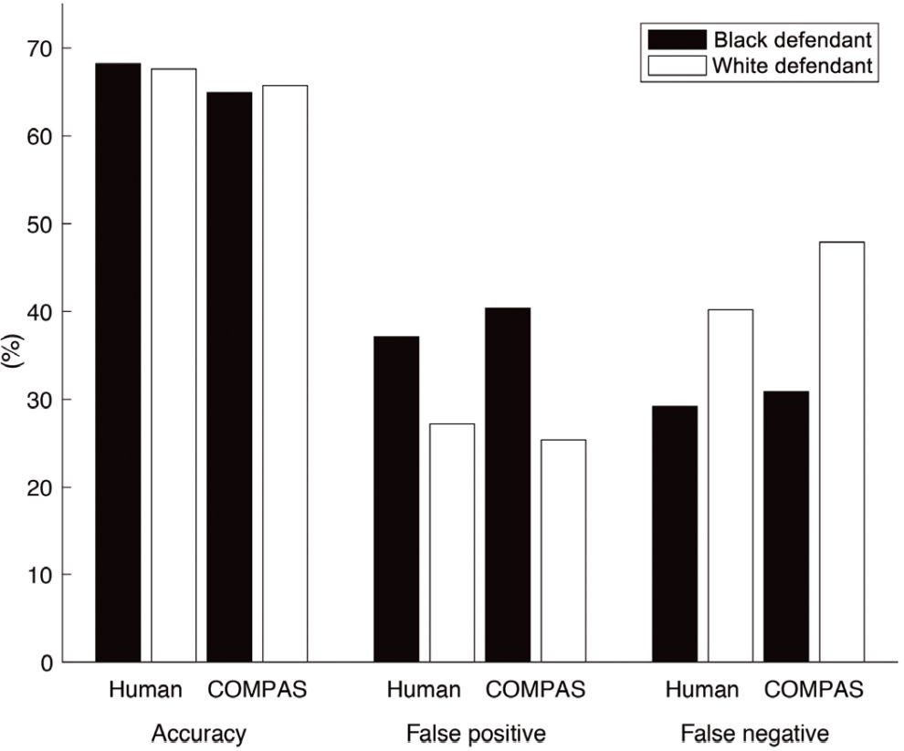
Algorithmic Bias
Commercial risk assessment software known as COMPAS
Assess more than 1 million offenders since 2000
Predicts a defendant’s risk of committing a misdemeanor or felony
137 features
Dressel et al, 2018

Slide 8
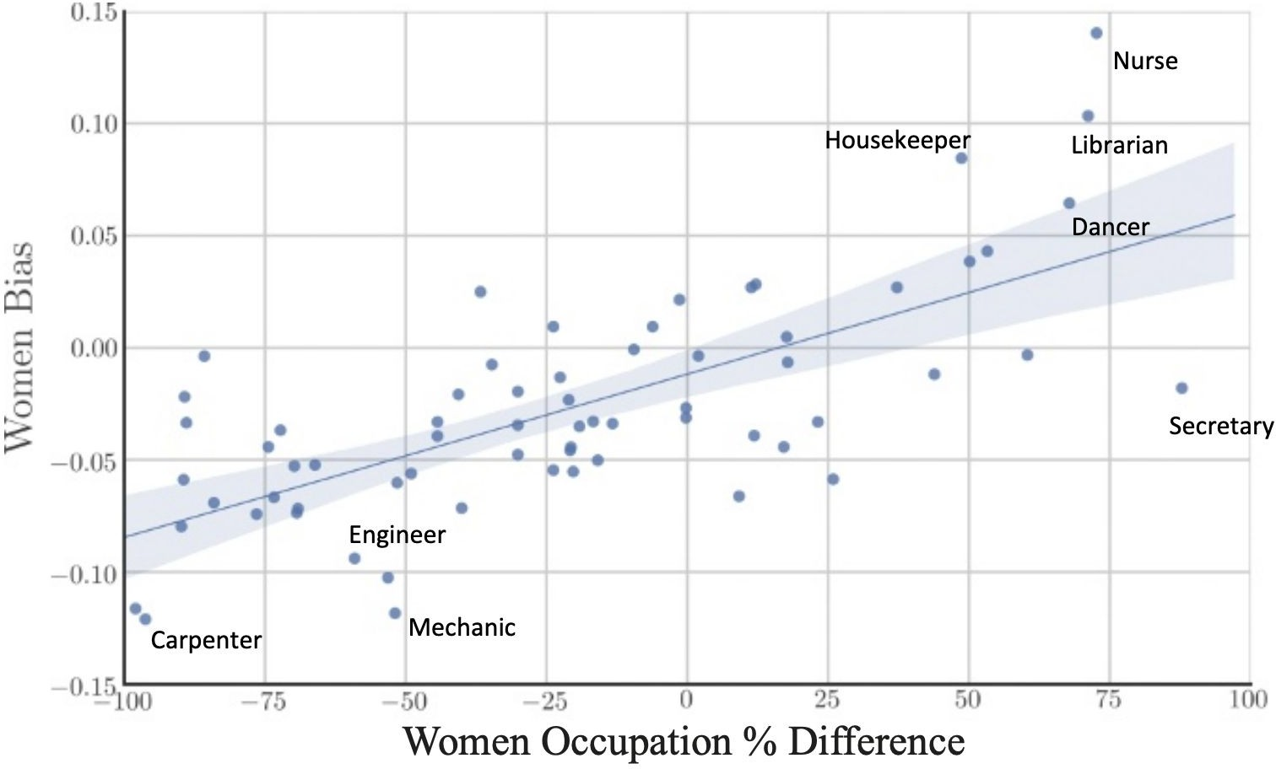
Bias in Historical Data – Negative Legacy
Gard et al, 2018

Slide 9
Fairness
https://www.borealisai.com/research-blogs/tutorial1-bias-and-fairness-ai/
What is Fairness?
The absence of bias towards an individual or a group (Mehrabi et al, 2019)
Can ML Models Discriminate?
Aren't machines just follow human's instructions?
ML models approximate patterns in the data
Learns/Amplifies biases at the same time

Slide 10
Fairness Through Unawareness
A ML Algorithm Achieves Fair Through Unawareness If
None of the sensitive features are directly used in the model
Race and Ethnicity | Skills | Years of Exp | Hired?
Hispanic | Javascript | 1 | no
Hispanic | C++ | 5 | yes
White | Java | 2 | yes
White | C++ | 3 | yes
Fair ML Model
Training

Slide 11
Issues With Fairness Through Unawareness
Fairnes through Unawareness
Sensitive Features May Still Be Used
Inferred from indirect evidence
Inferred
Protected
Race and Ethnicity | Skills | Years of Exp | Often Goes to Mexican Markets | Hiring Decision | Training
Hispanic | Javascript | 1 | yes | no
Hispanic | C++ | 5 | yes | yes
White | Java | 2 | no | yes
White | C++ | 3 | no | yes
Discriminatory ML Model

Slide 12
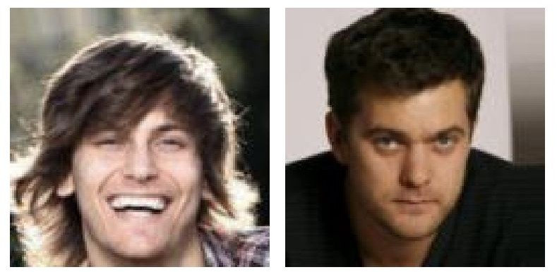
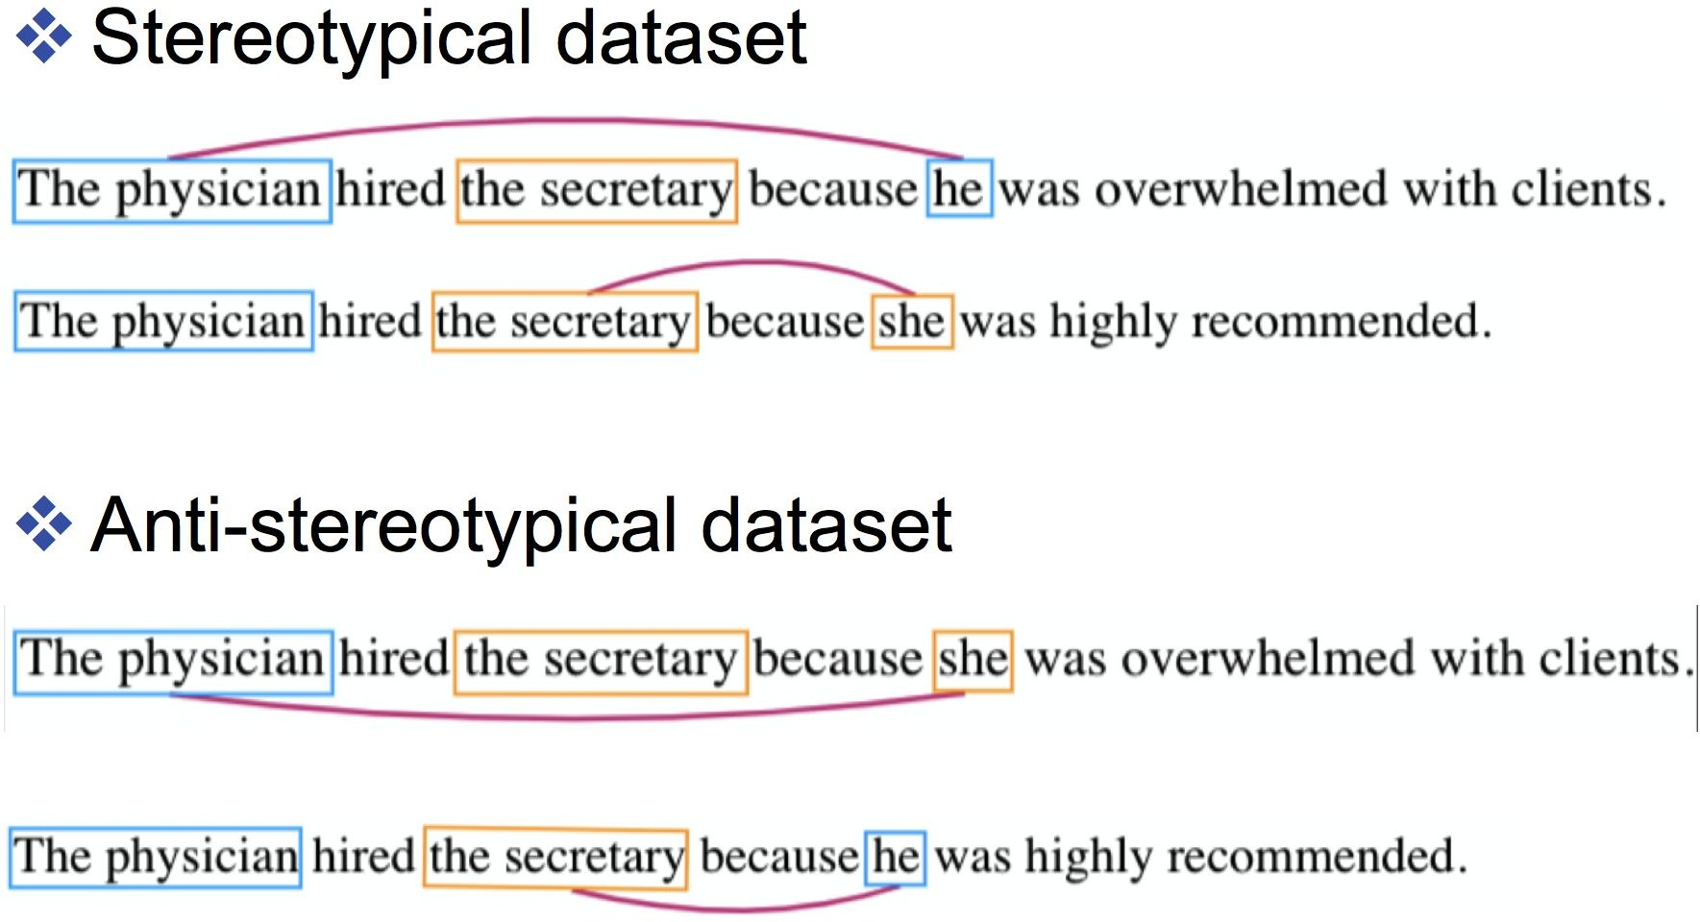
Limitations
Processing Sensitive Features
Fairness through unawareness requires sensitive features to be masked out
Not easy to do in real life
Referred to as individual fairness criteria

Slide 13
Need for ML Interpretability
Our society has been shifted to rely on AI more than ever
autonomous vehicles
Security
Finance
many others
Who will benefit from ML Interpretability?
End Users: enhance trust, understand the consequences of the decisions, e.g., privacy, fairness.
Regulatory Agencies: compliance, audits, and accountability.
Model Designers: diagnose model performance

Slide 14
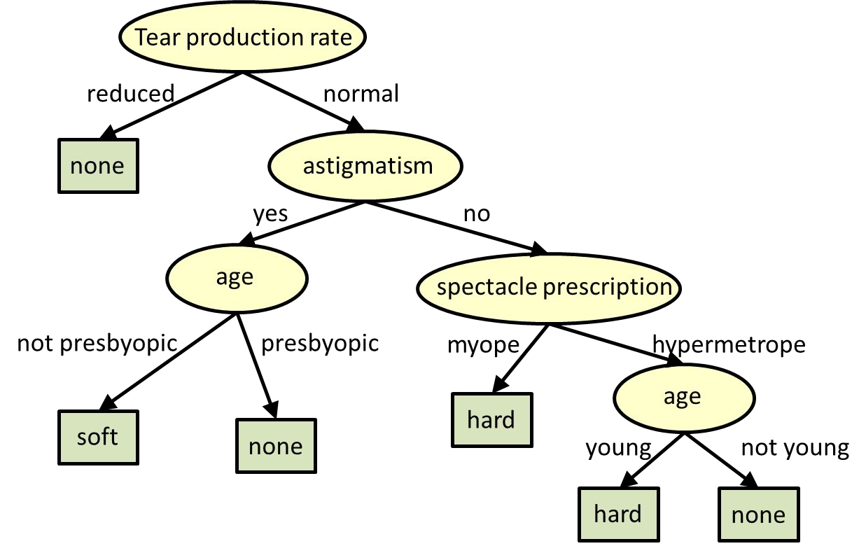
Interpretability in Decision Tree
ML interpretability allows one to examine model's basis in its decision making process
An interpretable tree model to find out the kind of contact lens a person may wear

Slide 15
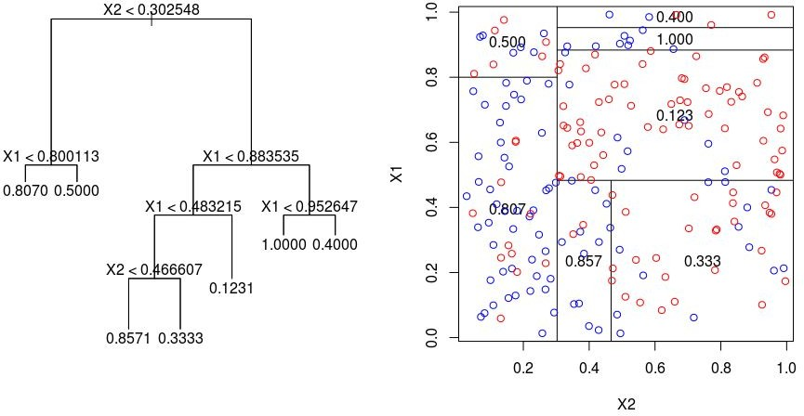
Interpretability in Decision Trees

Slide 16
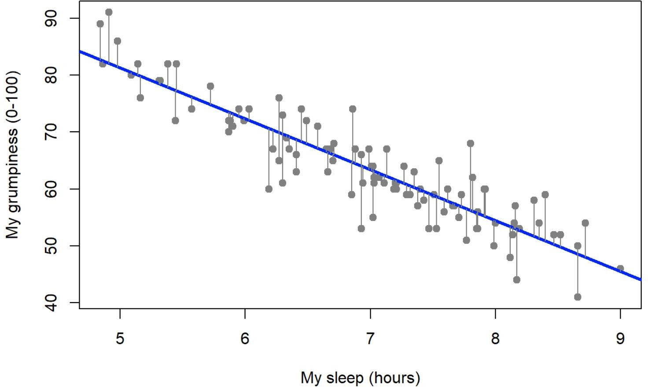
Interpretability in Linear Regression
interpretable components

Slide 17
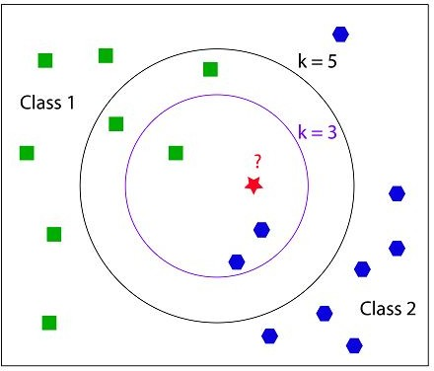
Interpretability in K-Nearest Neighbors

Slide 18
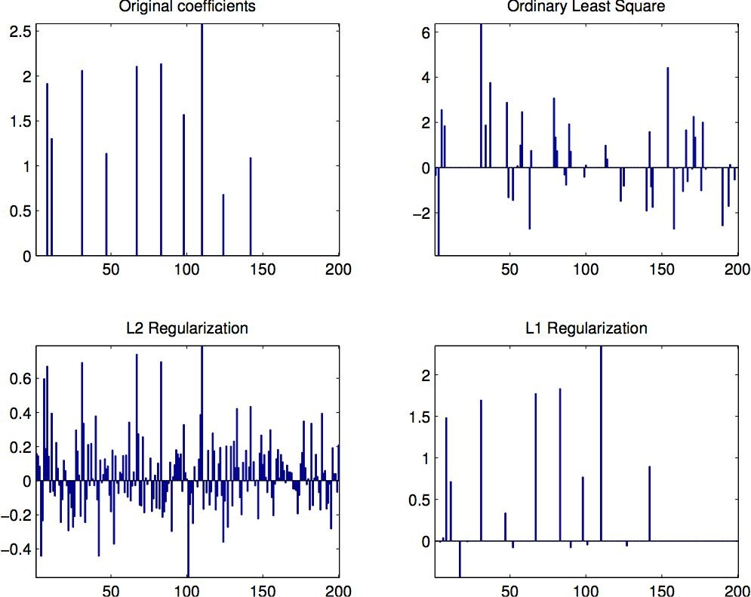
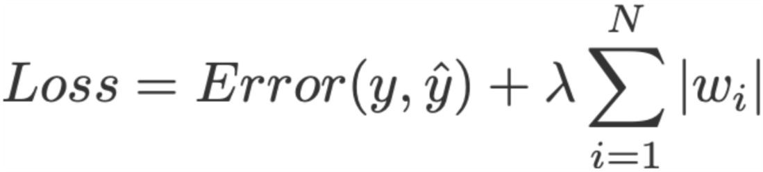
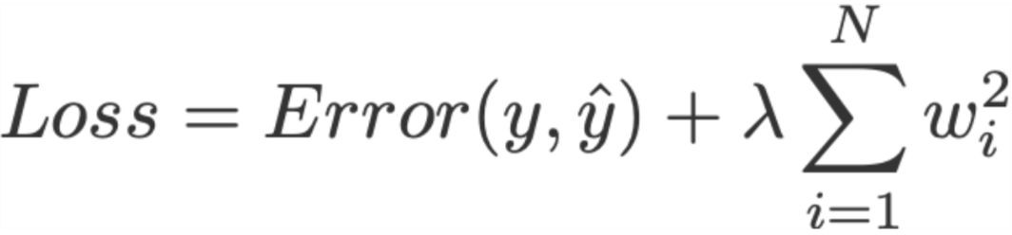
Sparsity for Interpretable Linear Regression
In the case of linear regression
○
Linear regression with L1 regularization
Linear Regression with L2 regularization

Slide 19
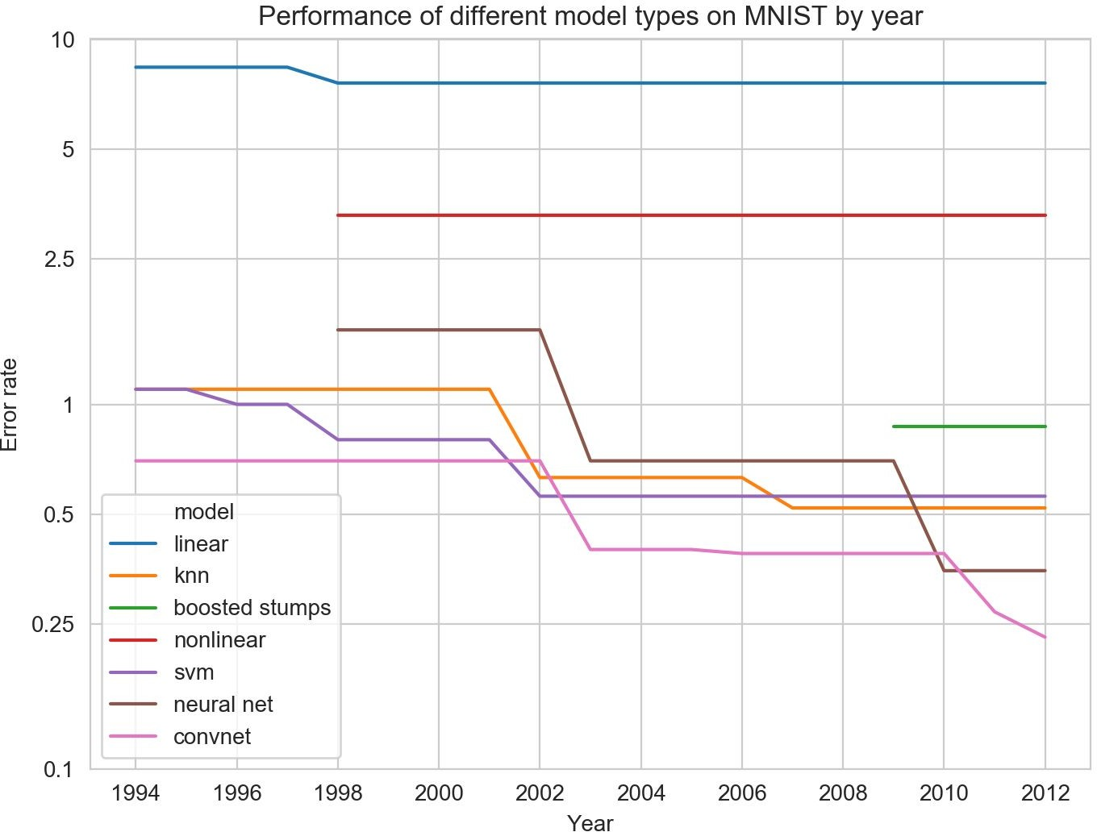
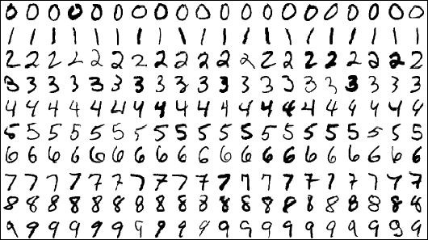

Interpretability and Performance Trade-offs
Highly performed models tend to be less interpretable.
Can powerful models with complex structures be interpretable at the same time?
more interpretable
less interpretable
MNIST Dataset
http://yann.lecun.com/exdb/mnist/ https://soph.info/2018/11/08/mnist-history/

Slide 20
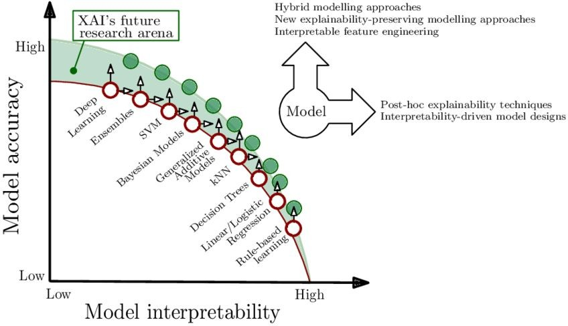
Interpretability and Performance Trade-offs
Arrieta et al., 2019

